Slide 1
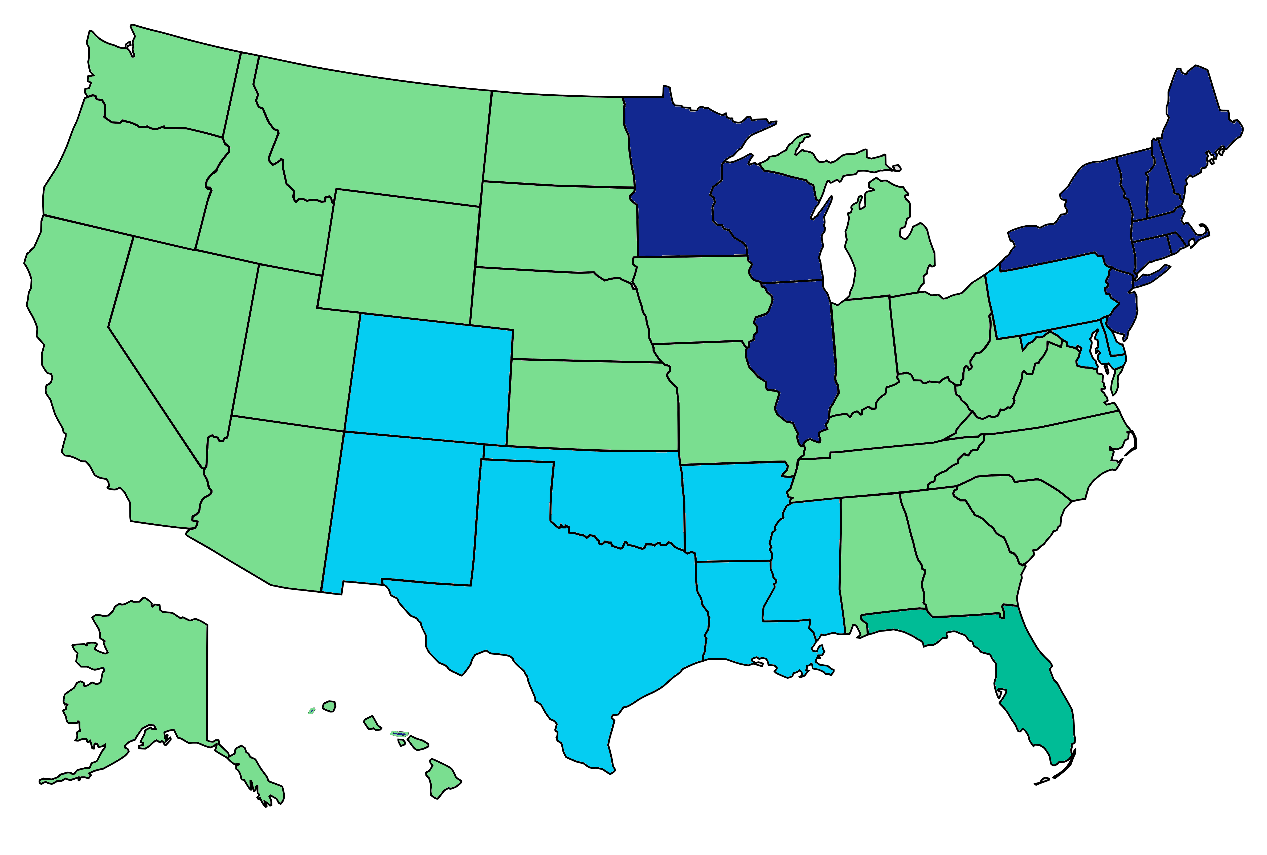
Clinical Lab Coverage Map
MolDX
NGS
Novitas
First Coast Service Options
© 2024 Gettysburg Healthcare Consulting, LLC
www.policypros.net

